Slide 1


Jaynes-Cummings Model and Cavity QED
Brant Norris
Department of Electrical and Computer Engineering
Herbert Wertheim College of Engineering
University of Florida
*Email: brantnorris@ufl.edu

Slide 2
Outline
Recent Literature Readings
Jaynes-Cummings Model
Microwave Cavity Coupling
Optical Cavity Coupling
Phonon Cavity Coupling
What’s Next

Slide 3

Recent Literature Readings
Section 1

Slide 4
Recent Literature Readings
Superconducting Qubit Systems (Engineering Perspective)
Dynamical Decoupling and Dephasing/Coherence Time Optimization
Optomechanics (radiation pressure and laser cooling)
Jaynes-Cummings Model
Microwave cavity couplings
Phonon cavity couplings
Optical cavity couplings
Silicon qubit systems

Slide 5
Jaynes-Cummings Model
Section 2

Slide 6
Jaynes-Cummings Model
The Jaynes-Cummings model is a fully quantum mechanical model of an atom in a field. It consists of a two-level system (atom) coupled to a quantized single-mode field (harmonic oscillator). When the field contains a statistical distribution of photon numbers, the oscillations collapse to an expected steady value.
This causes Rabi oscillations to collapse and revive repeatedly in complex patterns.
During dormant intervals of collapsed Rabi oscillations, the atom and field exist in a state of macroscopic superposition.

Slide 7
Jaynes-Cummings Model
Each photon creation accompanies an atomic de-excitation. Thus, a conservation of excitation occurs (in addition to the conservation of atomic probability).
The Rabi oscillations of the Jaynes-Cummings model differ greatly from normal, irreversible, exponential decay that occurs in free space. This is because an atom within a cavity undergoes reversible spontaneous emission as it repeatedly emits and then re-absorbs radiation energy.

Slide 8
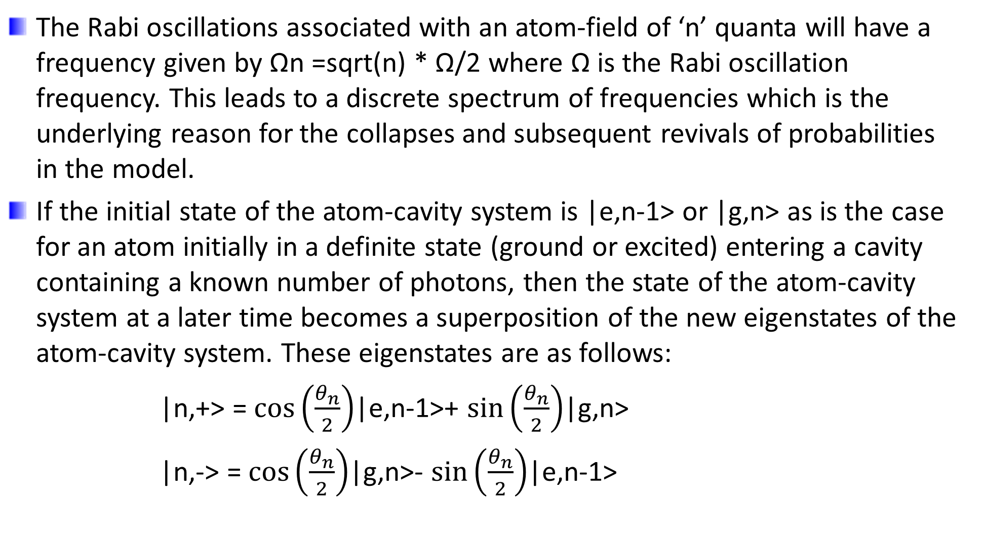
Jaynes-Cummings Model
The Rabi oscillations associated with an atom-field of ‘n’ quanta will have a frequency given by Ωn =sqrt(n) * Ω/2 where Ω is the Rabi oscillation frequency. This leads to a discrete spectrum of frequencies which is the underlying reason for the collapses and subsequent revivals of probabilities in the model.
If the initial state of the atom-cavity system is |e,n-1> or |g,n> as is the case for an atom initially in a definite state (ground or excited) entering a cavity containing a known number of photons, then the state of the atom-cavity system at a later time becomes a superposition of the new eigenstates of the atom-cavity system. These eigenstates are as follows:
|n,+> = $\cos\left(\frac{θ_{n}}{2}\right)$|e,n-1>+ $\sin\left(\frac{θ_{n}}{2}\right)$|g,n>
|n,-> = $\cos\left(\frac{θ_{n}}{2}\right)$|g,n>- $\sin\left(\frac{θ_{n}}{2}\right)$|e,n-1>

Slide 9
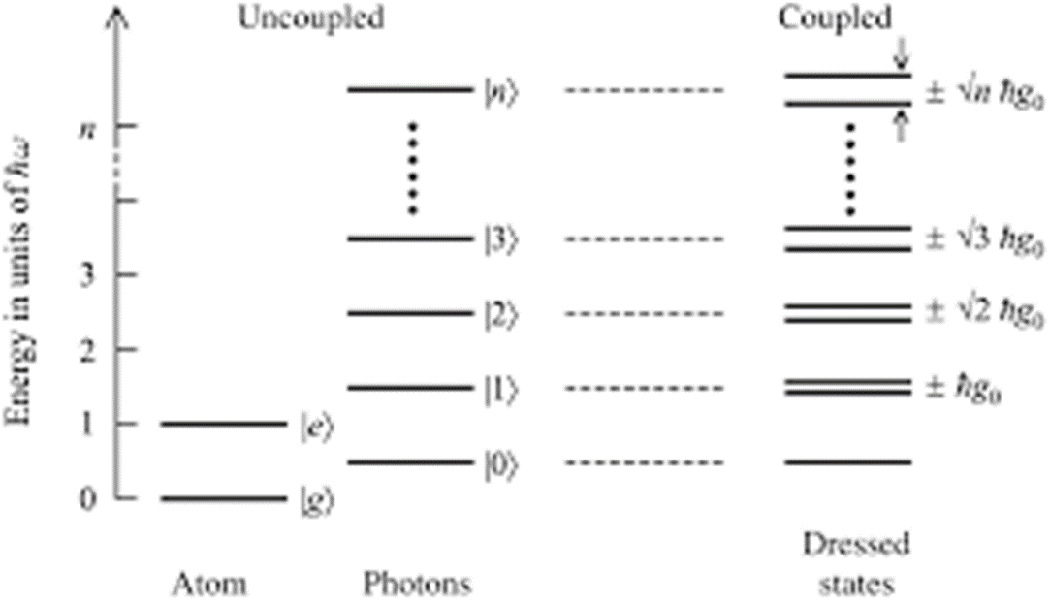
Jaynes-Cummings Model
This change in eigenstates due to the atom-field interaction causing a change in the Hamiltonian is referred to as dressing the atom. This leads us to the Jaynes-Cummings ladder:

Slide 10
Jaynes-Cummings Model
This Jaynes-Cummings model “ladder” is the depiction of the quantized energy levels that scale non-linearly as a function of the total number of quanta in the coupled system. It scales at a rate of $\sqrt{n}$.

Slide 11
Microwave Cavity Coupling
Section 3

Slide 12
Microwave Cavity Coupling
Paper: Optomechanical coupling between a multilayer graphene mechanical resonator and a superconducting microwave cavity by: V. Singh, S. J. Bosman, B. H. Schneider, Y. M. Blanter, A. Castellanos-Gomez and G. A. Steele

Slide 13
Microwave Cavity Coupling
Measurement Temps: 14mK (fig. 1), 14mK (fig. 2), 96mK (fig. 3)
Device Specs: 4-μm diameter multilayer. 10-nm thick. Graphene resonator suspended 150 nm above the gate.

Slide 14
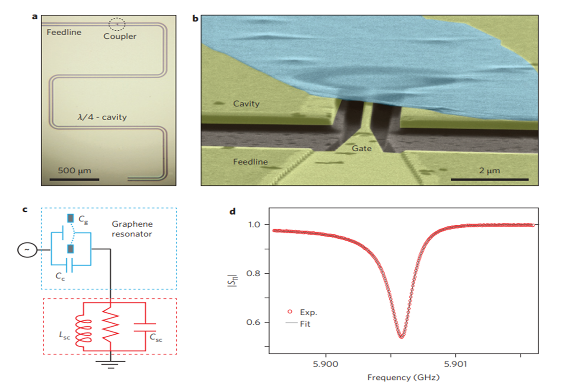
Microwave Cavity Coupling
Figure 1 | Characterization of the superconducting cavity coupled to a multilayer graphene mechanical resonator. a, Optical image of a superconducting cavity in a quarter-wave coplanar waveguide geometry. Microwave photons are coupled in and out of the cavity via a feedline that is capacitively coupled to the coplanar waveguide centre conductor by a gate capacitor (coupler). b, This gate capacitor includes a small gate electrode that extends from the feedline into the coplanar waveguide centre conductor. The tilted angle scanning electron micrograph (false colour) near the coupler shows a 4-μmdiameter multilayer (10-nm-thick) graphene resonator (cyan) suspended 150 nm above the gate. c, Schematic lumped element representation of the device with equivalent lumped parameters of capacitance Csc ≈ 415 fF and inductance Lsc ≈ 1.75 nH. d, Reflection coefficient |S11| of the superconducting cavity measured at T = 14 mK (red). The grey curve is a fit to the data, giving an internal quality factor of Qi ≈ 107,000 and loaded quality factor of QL ≈ 24,250.

Slide 15
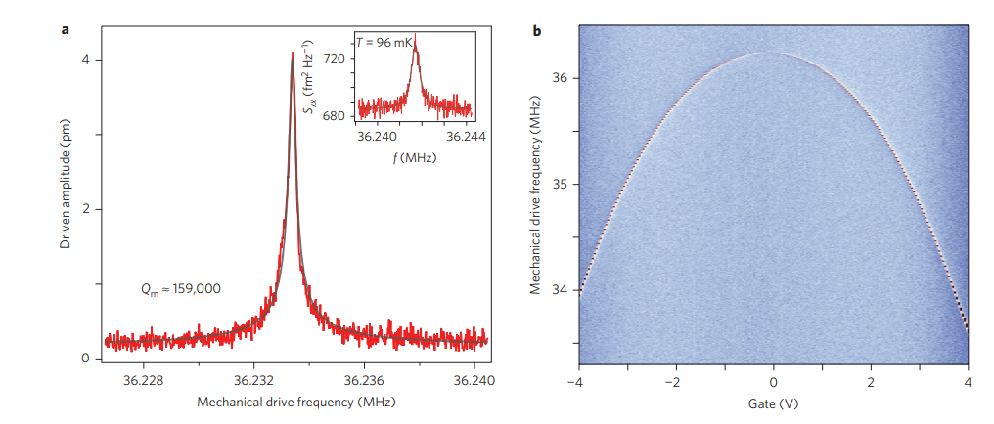
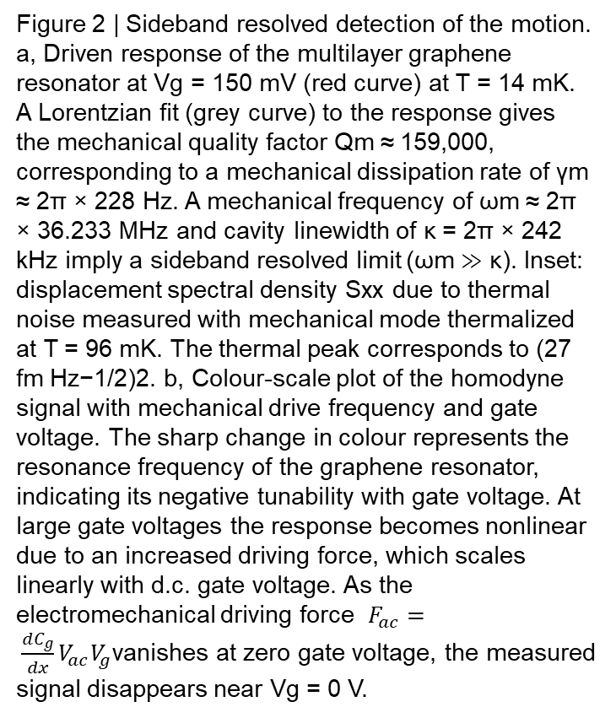
Microwave Cavity Coupling
Figure 2 | Sideband resolved detection of the motion. a, Driven response of the multilayer graphene resonator at Vg = 150 mV (red curve) at T = 14 mK. A Lorentzian fit (grey curve) to the response gives the mechanical quality factor Qm ≈ 159,000, corresponding to a mechanical dissipation rate of γm ≈ 2π × 228 Hz. A mechanical frequency of ωm ≈ 2π × 36.233 MHz and cavity linewidth of κ = 2π × 242 kHz imply a sideband resolved limit (ωm ≫ κ). Inset: displacement spectral density Sxx due to thermal noise measured with mechanical mode thermalized at T = 96 mK. The thermal peak corresponds to (27 fm Hz−1/2)2. b, Colour-scale plot of the homodyne signal with mechanical drive frequency and gate voltage. The sharp change in colour represents the resonance frequency of the graphene resonator, indicating its negative tunability with gate voltage. At large gate voltages the response becomes nonlinear due to an increased driving force, which scales linearly with d.c. gate voltage. As the electromechanical driving force $F_{ac}= \frac{dC_{g}}{dx}V_{ac}V_{g}$vanishes at zero gate voltage, the measured signal disappears near Vg = 0 V.

Slide 16
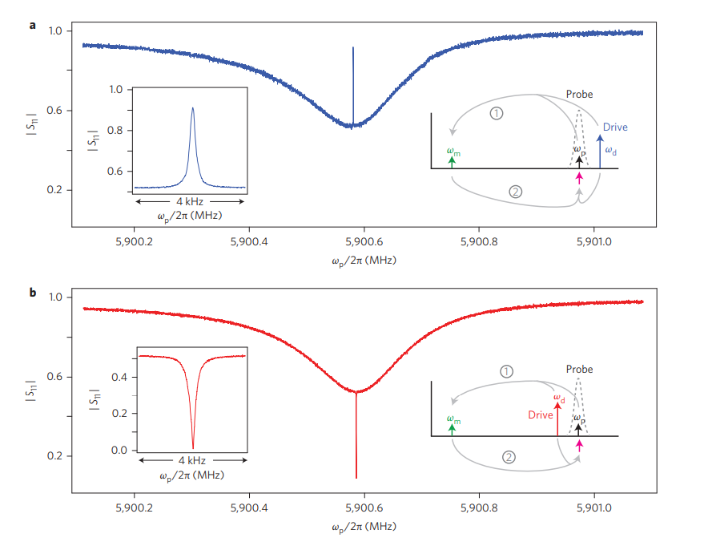
Microwave Cavity Coupling
Figure 3 | Optomechanically induced absorption (OMIA) and optomechanically induced reflection (OMIR). Measurement of the cavity reflection |S11| in the presence of sideband detuned drive tone at Vg = 0 V. a, A blue detuned drive results in a window of OMIR in the cavity response. Inset: zoomed view of the OMIR window. b, A red detuned sideband drive opens an OMIA feature in the cavity response. Inset: zoomed view of the OMIA. Schematics in a and b illustrate the OMIR and OMIA features in terms of the interference of the probe field (black arrow) with the microwave photons, which are cyclically down and then upconverted by the optomechanical interaction (pink arrow).

Slide 17
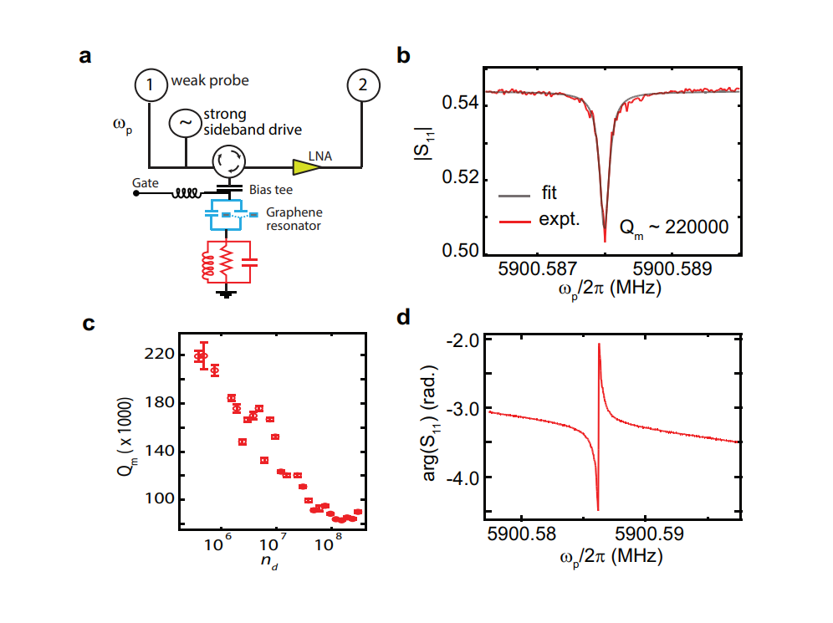
Microwave Cavity Coupling
Supplementary Fig. 8: (a) Measurement scheme to probe optomechanical interaction. (b) Detailed measurement of OMIA feature measured with low optomechanical coupling strength (red) along with the fitted curve (gray). (c) Plot of the mechanical quality factor with red detuned intracavity photon number nd extracted from the OMIA/OMIR data. (d) Plot of phase of the reflection coefficient measured with red detuned drive. The phase swing in the mechanical bandwidth corresponds to a group delay of ≈10 ms.

Slide 18
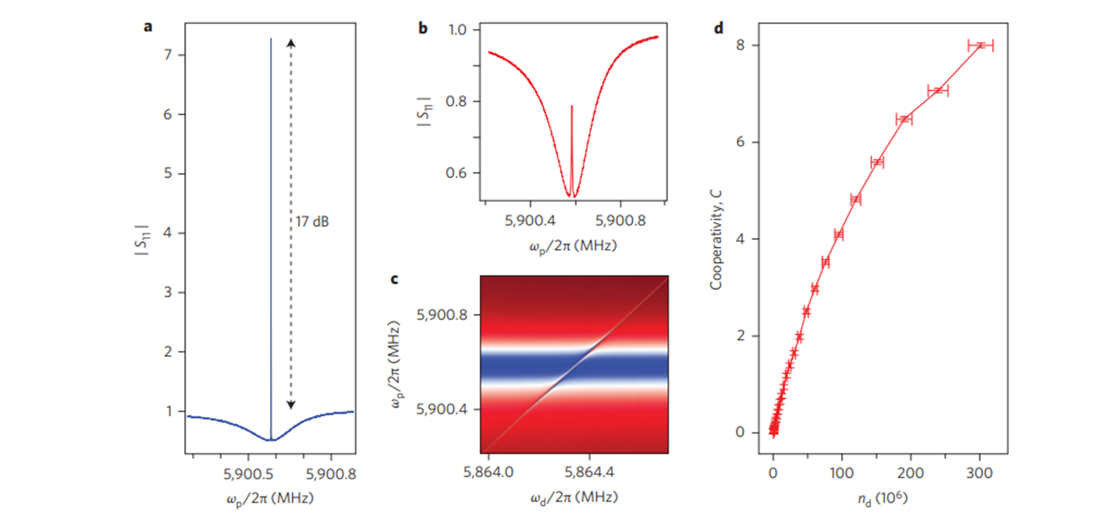
Microwave Cavity Coupling
Figure 4 | Large cooperativity with a multilayer graphene mechanical resonator. a, Measurement of the cavity reflection |S11| under a strong blue detuned drive (nd ≈ 1.5 × 107 ). At the centre of the cavity response, the reflection coefficient exceeds 1, corresponding to mechanical microwave amplification of 17 dB by the graphene resonator. b, Measurement of the cavity reflection |S11| under a strong red detuned drive (nd ≈ 3 × 108 ). With strong red detuned drive, the optomechanically induced absorption feature becomes optomechanically induced reflection and we observe the onset of the normal mode splitting, also visible in the colourscale plot in c as an avoided crossing while sweeping the drive frequency across the red sideband. The sweep measurement was performed with constant drive power. d, Plot of cooperativity C versus number of red detuned photons nd, in which we obtained C = 8. Horizontal error bars result from the statistical uncertainty in determining the single-photon coupling strength (g0), dissipation rate (κ) and mechanical dissipation rate (γm)

Slide 19
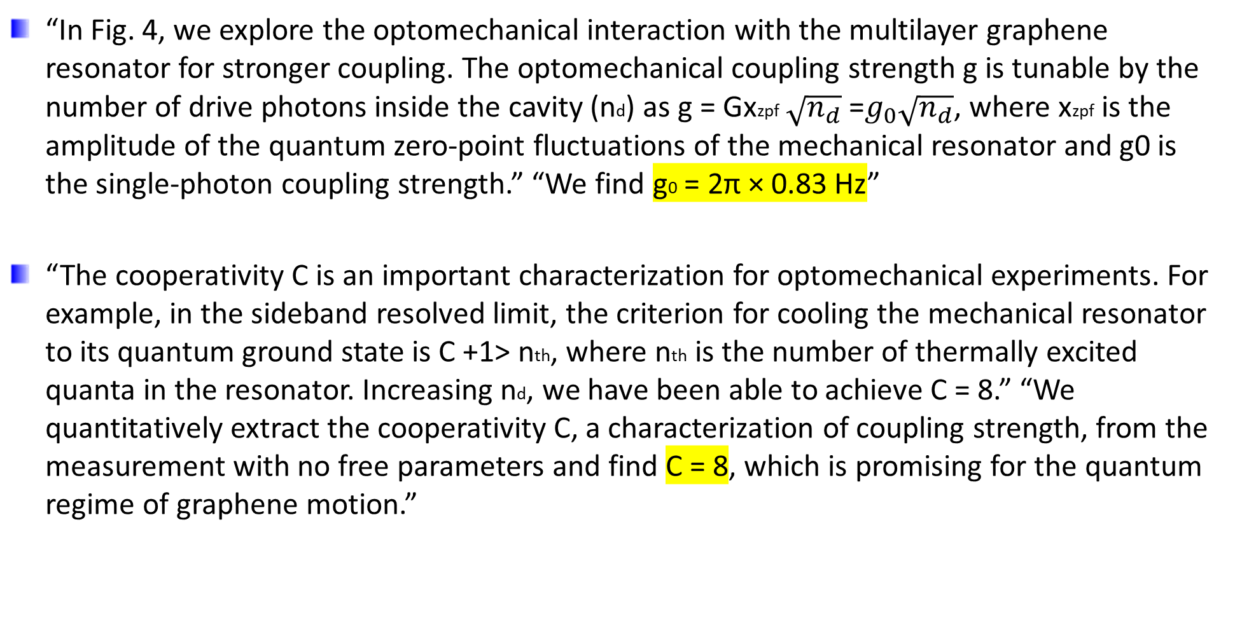
Microwave Cavity Coupling
“In Fig. 4, we explore the optomechanical interaction with the multilayer graphene resonator for stronger coupling. The optomechanical coupling strength g is tunable by the number of drive photons inside the cavity (nd) as g = Gxzpf $\sqrt{n_{d}}$ =$g_{0}\sqrt{n_{d}}$, where xzpf is the amplitude of the quantum zero-point fluctuations of the mechanical resonator and g0 is the single-photon coupling strength.” “We find g0 = 2π × 0.83 Hz”
“The cooperativity C is an important characterization for optomechanical experiments. For example, in the sideband resolved limit, the criterion for cooling the mechanical resonator to its quantum ground state is C +1> nth, where nth is the number of thermally excited quanta in the resonator. Increasing nd, we have been able to achieve C = 8.” “We quantitatively extract the cooperativity C, a characterization of coupling strength, from the measurement with no free parameters and find C = 8, which is promising for the quantum regime of graphene motion.”

Slide 20
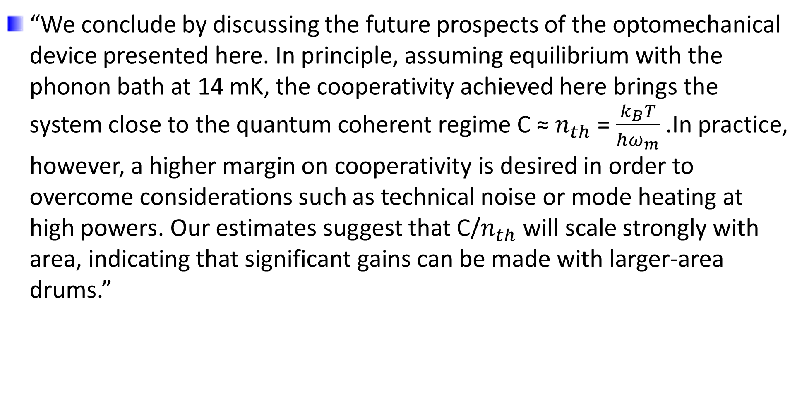
Microwave Cavity Coupling
“We conclude by discussing the future prospects of the optomechanical device presented here. In principle, assuming equilibrium with the phonon bath at 14 mK, the cooperativity achieved here brings the system close to the quantum coherent regime C ≈ $n_{th}$ = $\frac{k_{B}T}{{hω}_{m}}$ .In practice, however, a higher margin on cooperativity is desired in order to overcome considerations such as technical noise or mode heating at high powers. Our estimates suggest that C/$n_{th}$ will scale strongly with area, indicating that significant gains can be made with larger-area drums.”

Slide 21
Optical Cavity Coupling
Section 4

Slide 22
Optical Cavity Coupling
Paper: Evanescent-Field Optical Readout of Graphene Mechanical Motion at Room Temperature by: Robin M. Cole, George A. Brawley, Vivekananda P. Adiga, Roberto De Alba, Jeevak M. Parpia, Bojan Ilic, Harold G. Craighead, and Warwick P. Bowen

Slide 23
Optical Cavity Coupling
Measurement Temps: Room temperature (300K)
Device Specs: 70-μm-diameter graphene resonator and a 60-μm diameter microsphere (Figs 1-3). 20-μm-diameter resonator (Fig 4).

Slide 24
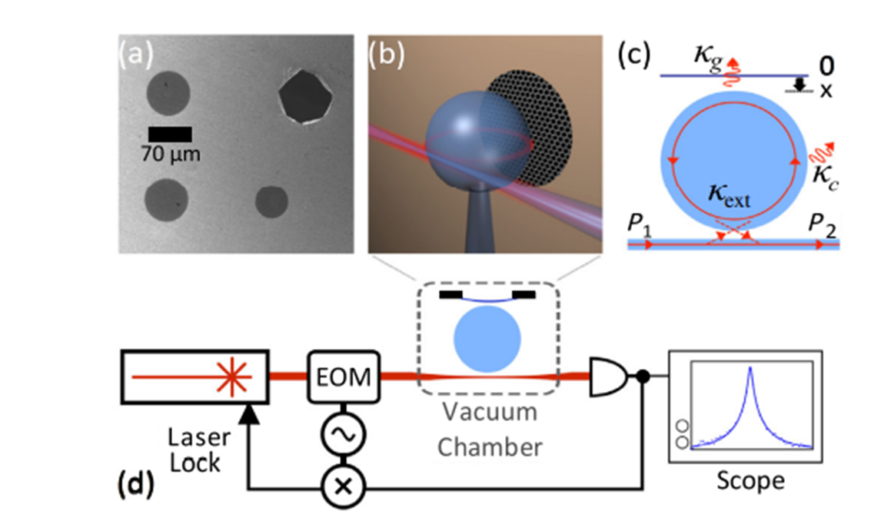
Optical Cavity Coupling
FIG. 1. (a) SEM image of a graphene drum resonators; a broken drum shows the contrast due to the graphene. (b) Illustration showing a microsphere with a graphene resonator in the evanescent field. (c) Illustration showing the optical coupling rates associated with the cavity measurement, discussed in the text. (d) Schematic of the measurement system.

Slide 25
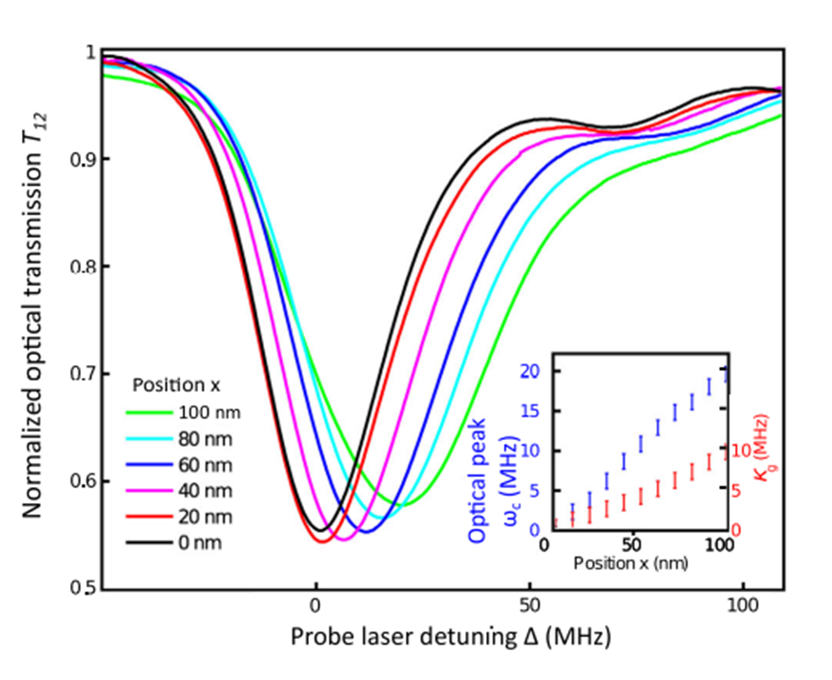
Optical Cavity Coupling
FIG. 2. Experimentally measured normalized transmission (T12) spectra with the position of the graphene resonator x within the evanescent field. At 0 nm, the graphene is far from the microsphere surface; at 100 nm, it is almost touching. Laser detuning is defined as Δ = 0 at ωc for the x = 0 nm spectra. (Inset) Extracted optical resonance frequency ωc and loss due to the graphene κg.

Slide 26
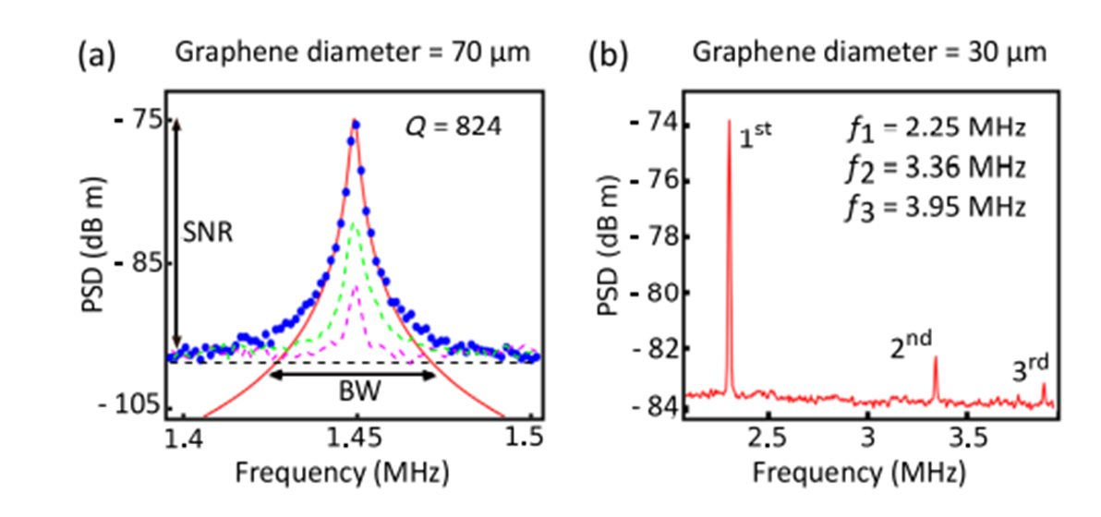
Optical Cavity Coupling
FIG. 3. (a) Measured spectrum showing the fundamental mechanical resonance of a 70-μm-diameter graphene drum, spectrum analyzer resolution bandwidth (RBW) = 100 Hz. The traces correspond to drum displacements of −30 (purple line), −15 (green line), and 0 nm (blue line) from the final position which gave the maximum signal transduction. (b) Spectra showing the three lowest-order resonances of a 30-μm-diameter resonator, RBW = 10 kHz.

Slide 27
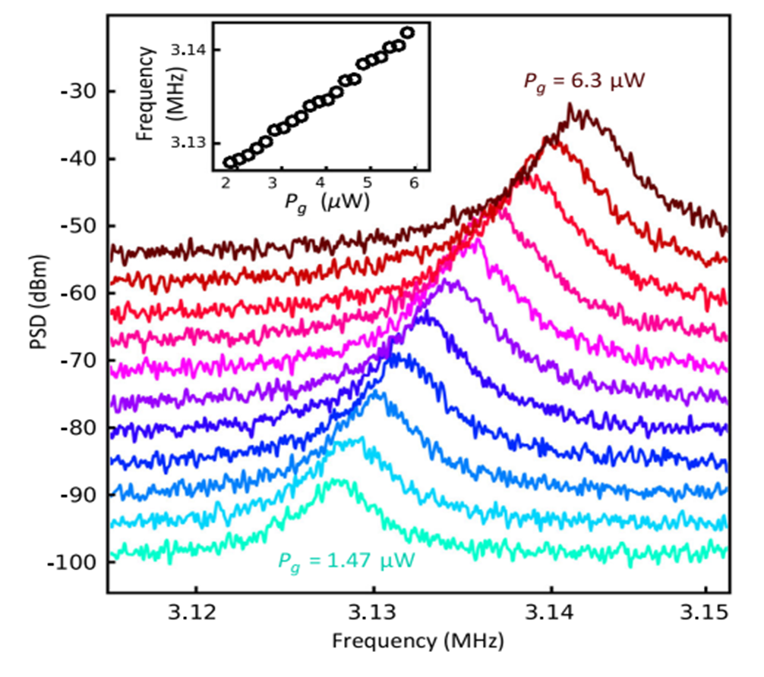
Optical Cavity Coupling
FIG. 4. Mechanical resonance spectra of a 20-μm-diameter resonator with optical power dissipated by the graphene Pg, with (inset) extracted resonance peak ωeff. Spectra are offset by 2.5 dB m on the vertical scale.

Slide 28
Optical Cavity Coupling
Optomechanical coupling coefficient G that quantifies the overlap of the optical field with the graphene resonator, such that G = ∂ωc/∂x.
By analogy to the dispersive coupling coefficient, we can define a dissipative optomechanical coupling coefficient Γdp = ∂κ/∂x.
Fitting spectra to ∂ω_{c}/G∂x and ∂κ = Γ_{dp}/∂x yields both dispersive G/2π = 0.21 MHz/nm and dissipative Γ_{dp/}2π = 0.1 MHz/nm coupling coefficients
Best coupling coefficient attained: G/Γdp = 2.1 which is favorable to the value of G/Γdp = 4 recently reported for a cavity torque sensor.
Cooperativity not mentioned in paper

Slide 29
Optical Cavity Coupling
“In principle, a significantly wider tuning range can be achieved by increasing the in-taper optical power P1. For example, a readily achievable P1 of 3 mW would increase the tuning range to 2 MHz, while incident powers as high as 400 mW have been reported recently”
“We demonstrate the readout of graphene NEMS motion at room temperature using cavity-enhanced evanescent sensing with high-Q optical microspheres. This approach enables ultrasensitive readout of the graphene oscillatory motion and paves the way for high-sensitivity and large-bandwidth room-temperature force measurements in a resonator mass regime not currently attainable by using silicon NEMS devices. We present the measurement of the dispersive and dissipative optomechanical coupling coefficients of graphene at visible wavelengths and show that material absorption does not result in poor readout sensitivity and only minimally heats the resonator. Finally, we exploit the optical absorption to tune the mechanical frequency of the graphene resonator and propose routes to improve the sensitivity of readout measurements.”

Slide 30
Phonon Cavity Coupling
Section 5

Slide 31
Phonon Cavity Coupling
Paper: Coherent phonon dynamics in spatially separated graphene mechanical resonators. By: Zhuo-Zhi Zhanga, Xiang-Xiang Songa, Gang Luoa, Zi-Jia Sua, Kai-Long Wanga, Gang Caoa, Hai-Ou Lia, Ming Xiaoa, Guang-Can Guoa, Lin Tianc, Guang-Wei Denga, and Guo-Ping Guo

Slide 32
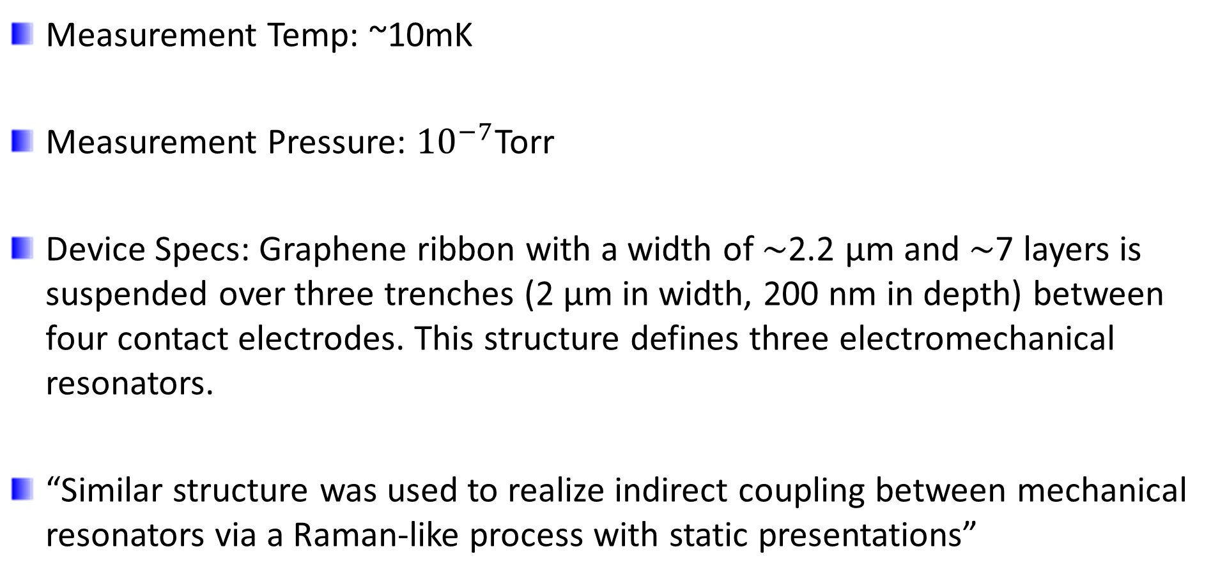
Phonon Cavity Coupling
Measurement Temp: ~10mK
Measurement Pressure: ${10}^{−7}$Torr
Device Specs: Graphene ribbon with a width of ∼2.2 μm and ∼7 layers is suspended over three trenches (2 μm in width, 200 nm in depth) between four contact electrodes. This structure defines three electromechanical resonators.
“Similar structure was used to realize indirect coupling between mechanical resonators via a Raman-like process with static presentations”

Slide 33
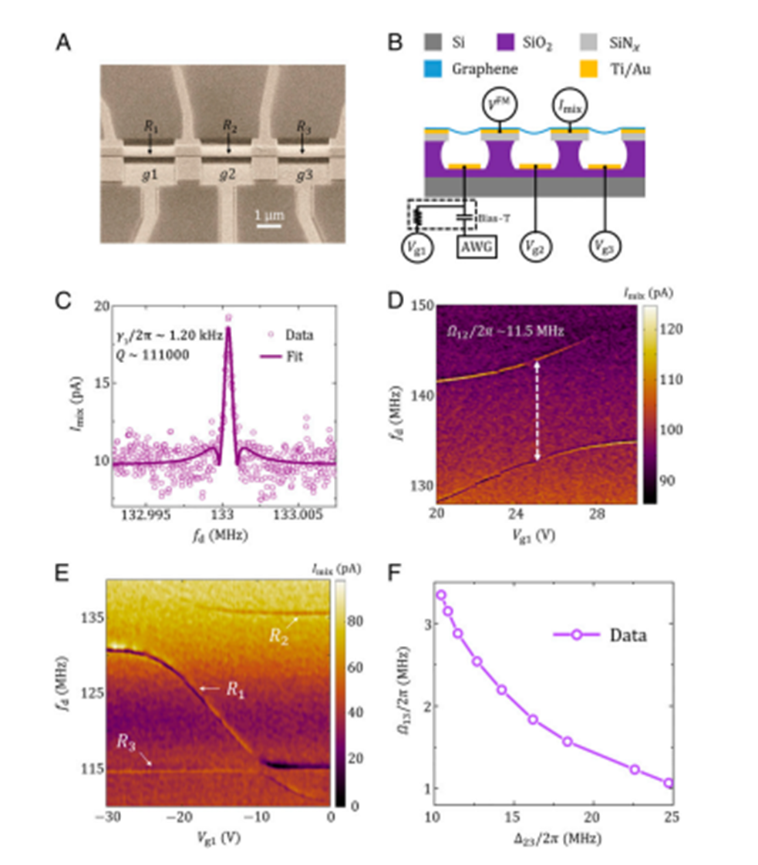
Phonon Cavity Coupling
Fig. 1. Sample structure and mode spectra of the resonators. (A) Scanning electron microscope image of a typical sample with a tilted view angle. Four contacts divide a suspended graphene ribbon into three mechanical resonators, R1, R2, and R3, in a linear chain. (B) Schematic sample structure and measurement setup. A frequency-modulated microwave signal VFM is applied through one contact of the center resonator, and a lock-in amplifier detects the mixing current Imix at the modulation frequency of the inputted FM signal at another contact. The frequencies of the resonators are tuned by dc voltages on the gates, respectively. An arbitrary waveform generator (AWG) is connected to gate g1 to provide additional burst signals for the coherent oscillations. (C) The mixing current as a function of the driving frequency fd at Vg1 = 22 V. The measured linewidth of resonator R1 is γ1/2π ∼ 1.20 kHz. Similarly, the linewidth of R2 is γ2/2π ∼ 1.16 kHz and the linewidth of R3 is γ3=2π ∼ 0.73 kHz (SI Appendix, Fig. S2) at a driving power of ∼− 60 dBm. (D) The mixing-current spectrum of resonators R1 and R2. Coupling strength as large as 11.5 MHz is observed. Here Vg2 = 17 V and Vg3 = 0 V. (E) Spectrum of all three resonators. Here R2 is far offresonance from R3 with a detuning Δ23/2π ∼ 20 MHz, with Vg2 = 14 V, and Vg3 = 15 V. The dc voltage Vg1 is scanned over a wide range, to tune the resonant frequency of R1 to cross the frequencies fm2 and fm3. A large avoided level crossing is observed when fm1 approaches fm2. A smaller energy splitting is observed when fm1 approaches fm3 due to the indirect coupling. (F) The measured indirect coupling strength Ω13=2π between R1 and R3 as a function of Δ23/2π. D and E are obtained at a driving power of ∼− 40 dBm to have a better resolution.

Slide 34
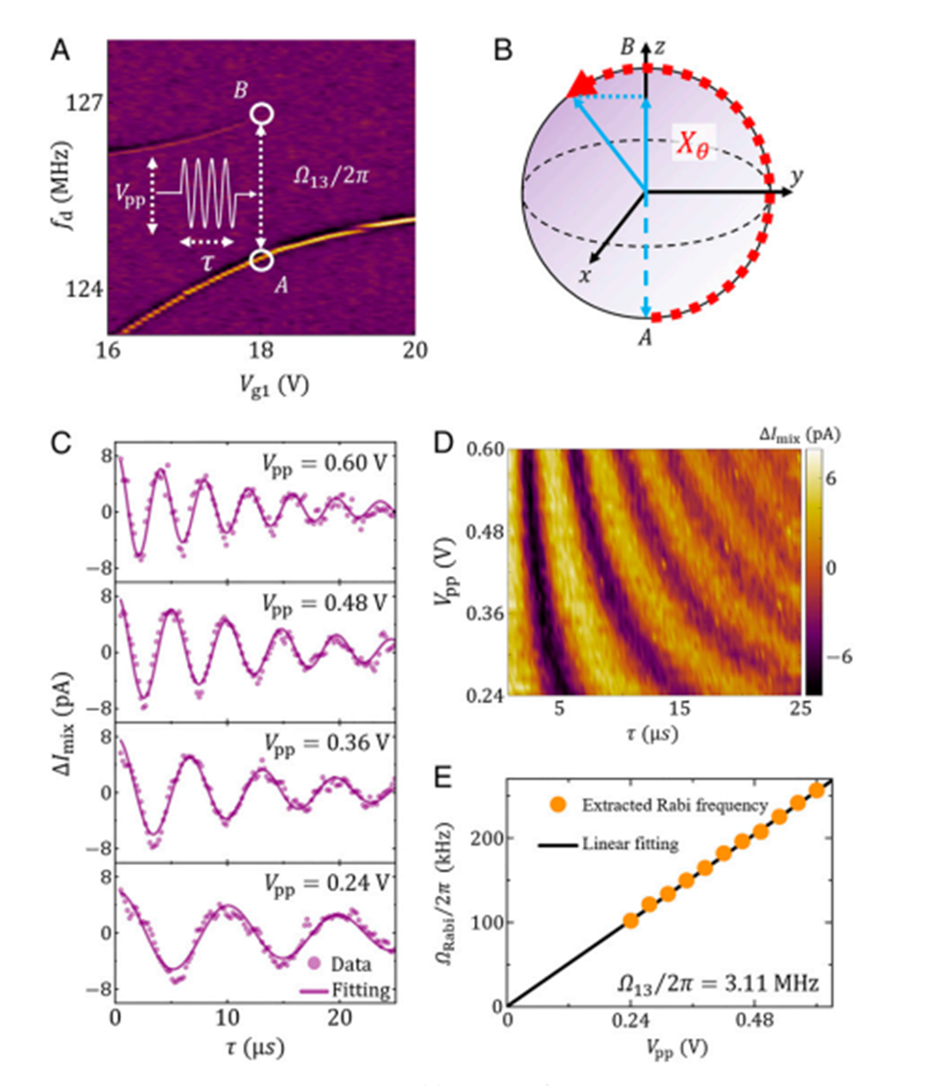
Phonon Cavity Coupling
Fig. 2. Phonon Rabi oscillations between spatially separated resonators. (A) Spectrum of R1 and R3 at Vg2 = 17.5 V and Vg3 = 22 V with effective coupling strength Ω13/2π = 3.11 MHz. During the experiment, we first excite the coupled system to eigenmode A, then apply a microwave burst to generate rotations around the x axis, and measure the mixing current at the frequency of eigenmode A. Each sequence is repeated for over 105 times to gather the data for the average mixing current. (B) Evolution of the system on the Bloch sphere. The dashed blue arrow marks the initial state. Under the microwave burst, the system rotates around the x axis, following the red trajectory, and the burst duration τ determines the rotation angle. (C) Average mixing current as a function of burst duration with microwave amplitudes Vpp = 0.60, 0.48, 0.36, and 0.24 V, respectively. The purple lines show the damped cosinusoidal fits to the experimental data. (D) The Rabi oscillation versus the microwave amplitude Vpp. (E) Extracted Rabi frequency Ωrabi/2π as a function of microwave amplitude in comparison with a linear fitting (black line).

Slide 35
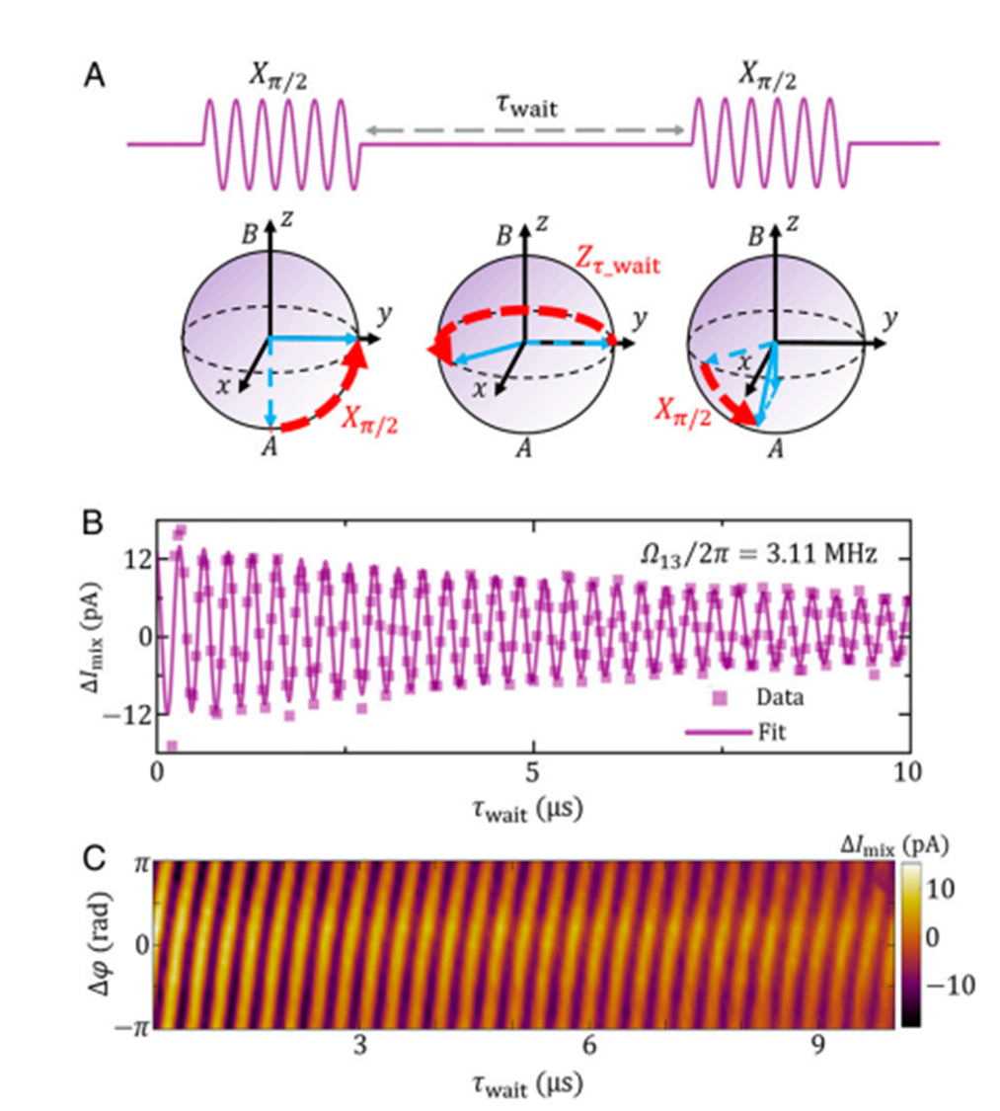
Phonon Cavity Coupling
Fig. 3. Phonon Ramsey interference between spatially separated resonators. (A) Pulse sequence and system evolution in the Bloch sphere during Ramsey interference experiment. The pulse sequence consists of a π/2 rotation around the x axis, a free evolution duration τwait, and a second pulse around the x axis (or a selected axis in the x-y plane). The dashed blue arrows indicate the initial state of this system. The dashed red arrows indicate the evolution trajectories. The solid blue arrows refer to the final state. (B) Average mixing current as a function of τwait with coupling strength Ω13=2π = 3.11 MHz. The solid line is the numerical fitting using a damped cosinusoidal function, which gives an oscillation frequency Ωramsey/2π = 3.12 MHz, in good agreement with the coupling strength. (C) Ramsey interferences versus waiting time and relative phase Δφ between the two π/2 pulses.

Slide 36
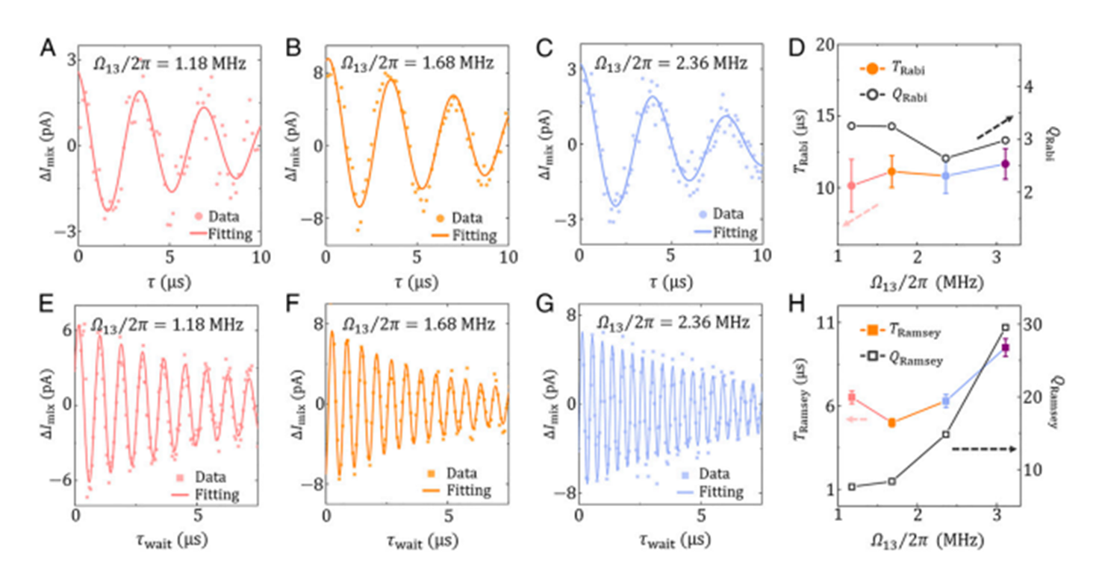
Phonon Cavity Coupling

Slide 37
Phonon Cavity Coupling
Caption for figure 4 on previous slide:
Fig. 4. Rabi and Ramsey oscillations at different coupling strengths. Phonon Rabi oscillations (A–C) and Ramsey interference (E–G) between spatially separated resonators at coupling strengths Ω13/2π = 1.18, 1.68, and 2.36 MHz, respectively. Solid lines are numerical fitting using damped cosinusoidal functions. (D) Damping times of Rabi oscillations TRabi and quality factor QRabi =TRabi × ΩRabi/2π as functions of coupling rate Ω13/2π. (H) Damping times of Ramsey interference TRamsey and quality factor QRamsey =TRamsey × ΩRamsey/2π as functions of coupling rate Ω13/2π. Error bars are given by fitting fidelities. Data points for Ω13/2π = 3.11 MHz are taken from Figures 2 and 3.

Slide 38
Phonon Cavity Coupling
The highly tunable coupling strength between resonators R₁ and R₃ offers promising prospect for phonon-state manipulation. We investigate the coherent dynamics under different coupling strength Ω₁₃/2π, which can be tuned by varying the detuning between R₁(R₃) and R₂. The oscillation frequencies (Ω_{Rabi}/2π and Ω_{ramsey}/2π, respectively), and damping times (T_{Rabi} and T_{Ramsey} respectively) are extracted from the measured data
By measuring the frequency splitting, the coupling strength between neighboring resonators was obtained with Ω₁₂/2π ∼ 11.5 MHz. Here the coupling between the neighboring resonators R₁ and R₂ leads to a normal mode that is spatially distributed over the range of R₁ and R₂. Similarly, we can measure the coupling strength between the neighboring resonators R₂ and R₃, Ω₂₃/2π, to be ∼9.0 MHz

Slide 39
Phonon Cavity Coupling
Cooperativity is a key parameter to characterize the coherence and the potential for coherent manipulation of coupled modes. At low driving power ∼−60 dBm, we can calculate the zero-temperature cooperativities with C12 = Ω₁₂² /γ₁γ₂ for resonators R₁ and R₂ reaching 9.5 × 10⁷ and C₂₃ = Ω₂₃² /γ₂γ₃ for resonators R₂ and R₃ reaching 9.6 × 10⁷
More importantly, with effective coupling strength, Ω₁₃/2π ∼3.3 MHz, between the non-neighboring resonators R₁ and R₃, the zero-temperature cooperativity C₁₃ = Ω₁₃²/γ₁γ₃ between these spatially separated modes exceeds 1.2 × 10⁷

Slide 40
Phonon Cavity Coupling
“We demonstrate coherent Rabi oscillations between spatially separated resonators indirectly coupled via an intermediate resonator serving as a phonon cavity. The Rabi frequency fits well with the microwave burst power on the control gate. We also observe Ramsey interference, where the oscillation frequency corresponds to the indirect coupling strength between these resonators. Such coherent processes indicate that information encoded in vibrational modes can be transferred and stored between spatially separated resonators, which can open the venue of on-demand phonon-based information processing.”
“We studied coherent phonon dynamics between spatially separated graphene mechanical resonators. The giant cooperativity in our sample enables the study of such coherent oscillations and the fitting of the damping times. Our demonstration of coherent dynamics between mechanical modes with indirect interaction and high tunability is a key step toward on-demand state transfer and manipulation in an all-phonon platform. With the capabilities of system integrations, our architecture can be extended to large scale for phonon-based computing and long-distance information exchange in mechanical systems.”

Slide 41
What’s Next
Section 6

Slide 42
What’s Next
Mapping PRA2007 paper to mechanical domain (NEMS)
Realize one-qubit cavity QEDs (fidelities, etc)
Control and Readout
Realize two-qubit gate operations
Check EDL paper with Si quantum dots (Dr. Guo)
Read 3 related Nature papers

Slide 43
Thanks!

